Slide 1
CERT Educational Series
Greg Monty PhD, Vicki Foust PhD, and Elizabeth Keele M.Ed
Heat Transfer

Slide 2
Are temperature and heat the same thing?
YES – 1 finger near chest
NO – 2 fingers near chest
Temperature and Heat are NOT the same thing

Slide 3
Heat Energy Defined
Heat is thermal energy that is transferred from matter at a higher temperature to matter at a lower temperature
Temperature is the measure of the average kinetic energy of particles in matter.
Heat Flow – If two objects have different temperatures, heat will flow from the warmer object to the cooler object

Slide 4
What is a unit?
A Unit is a quantity or measurement
For example, you hear the number 6
But 6 what???
Add the unit of measurement ‘feet’ to 6
6 feet! Now 6 has meaning

Slide 5
What are the units of temperature?
Temperature is measured three ways:
Degrees Celsius (ºC)
ºC = (ºF – 32) * (5/9)
Degrees Fahrenheit (ºF)
Kelvin (K )
K = 273 + ºC (for room temperature 23 ºC, it is about 300K)
Note: Kelvin does not have a degree symbol

Slide 6
What are the units of heat energy?
Hint: When you eat food, and you are dieting, you might want to know how many ________ the food has.
ANSWER: Calories!

Slide 7
Let’s Begin Experiment 1

Slide 8
Video of Apparatus Setup
Link to Apparatus Setup Video:
https://youtu.be/MRU0JJ0Thf8

Slide 9
Data Collection on Lab Sheet
Pick the first person to read the thermometers when the bell rings, and to report the temperature to the group
Everyone will record the temperatures on their Lab Sheet
Pick another person to read the thermometers when the bell rings again, and to report the temperature to the group for recording

Slide 10
Metal Bar Temperature: Before
Before we begin the experiment, we need to answer observation 1.
How does the metal bar feel BEFORE the experiment?
Your teacher will have students touch an aluminum bar, not in the apparatus, before the experiment begins.
ANSWER: The metal bar feels the same temperature on both ends of the bar.

Slide 11
Form Your Hypothesis
A hypothesis is your best guess about what will happen during the experiment
What do you think will happen to the metal bar during the experiment? Write your answer in the space under observation 2.

Slide 12
Metal Bar Temperature: During
Now that the apparatus is set up, feel the bar on both the A and B sides and the outside of the Styrofoam cup
Write your observation in the lab sheet.

Slide 13
Take Reading 1
READING | Cup A ºC | Cup B ºC
1
2
3
4
5
6

Slide 14
Take Reading 2 (at next bell)
READING | Cup A ºC | Cup B ºC
1
2
3
4
5
6

Slide 15
Metal Bar Temperature: During
Now feel the bar on both the A and B sides of the apparatus and the outside of the Styrofoam cup
Write your observation in the lab sheet.

Slide 16
Take Reading 3 (at next bell)
READING | Cup A ºC | Cup B ºC
1
2
3
4
5
6

Slide 17
Take Reading 4 (at next bell)
READING | Cup A ºC | Cup B ºC
1
2
3
4
5
6

Slide 18
Metal Bar Temperature: During
Now feel the bar on both the A and B sides of the apparatus and the outside of the Styrofoam cup
Write your observation in the lab sheet.

Slide 19
Take Reading 5 (at next bell)
READING | Cup A ºC | Cup B ºC
1
2
3
4
5
6

Slide 20
Take Reading 6 (at next bell)
READING | Cup A ºC | Cup B ºC
1
2
3
4
5
6

Slide 21
Lab Sheet Observation 3
Did the temperature of the bar change during the experiment?
What about the temperature of the water?
If so, what changes did you see?

Slide 22
What Happened in Experiment 1?
Temperature decreased in hot water
Temperature increased in cold water
Heat transferred from high temperature to low temperature
HIGH
2
LOW

Slide 23
What is Heat Transfer?
Heat Transfer is the movement of thermal energy from a warmer object to a cooler object
Conduction is heat transferred from one particle of matter to another without the movement of matter
Conductors transfer thermal energy well
Convection is heat transferred by the movement of currents within a fluid
Radiation is the transfer of energy by electromagnetic waves.

Slide 24
What is an Insulator?
Insulators are materials that do NOT transfer thermal energy well
Insulators slow the transfer of heat
Are you wearing an insulator?
Shoes, jackets, clothes are all insulators

Slide 25
Label Diagram for Experiment 1
Use Vocabulary Words
Conduction
Convection
Radiation
Insulator
Conductor
Hot Water, Cold Water
* Draw arrows for the direction of the heat flow
While you draw and label your Diagrams in the Worksheet, your apparatus for Exp. #1 will be picked up, and Exp. #2 apparatus will be delivered to your tables

Slide 26
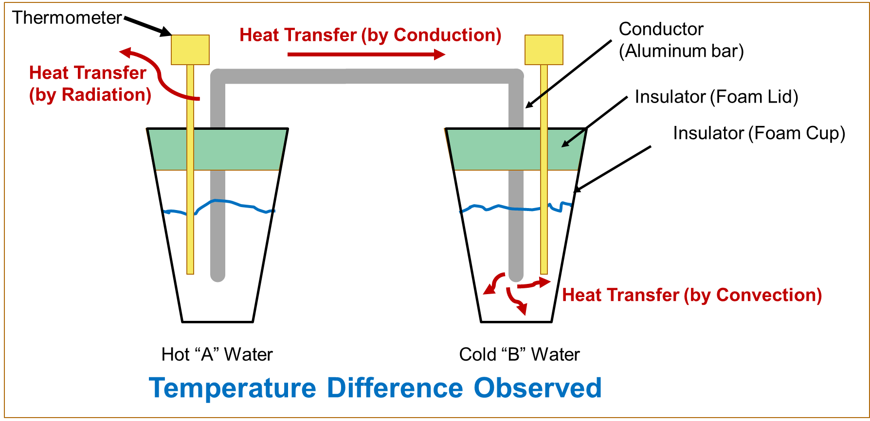

Slide 27
Let’s Begin Experiment 2

Slide 28
Metal Bar Temperature: Before
The metal bar will feel the same temperature on both ends like it did before experiment 1.

Slide 29
Form Your Hypothesis
In experiment 2, you will have 2 cups of tap water.
What do you think will happen to the metal bar during the experiment? Write your answer in the space under observation 4.

Slide 30
Data Collection
We will collect data the same way we did in experiment 1.

Slide 31
Take Reading 1
READING | Cup C ºC | Cup D ºC
1
2
3
4
5
6

Slide 32
Take Reading 2 (at next bell)
READING | Cup C ºC | Cup D ºC
1
2
3
4
5
6

Slide 33
Metal Bar Temperature: During
Now feel the bar on both the C and D sides of the apparatus and the outside of the Styrofoam cups
Write your observation in the lab sheet.

Slide 34
Take Reading 3 (at next bell)
READING | Cup C ºC | Cup D ºC
1
2
3
4
5
6

Slide 35
Take Reading 4 (at next bell)
READING | Cup C ºC | Cup D ºC
1
2
3
4
5
6

Slide 36
Metal Bar Temperature: During
Now feel the bar on both the C and D sides of the apparatus and the outside of the Styrofoam cups
Write your observation in the lab sheet.

Slide 37
Take Reading 5 (at next bell)
READING | Cup C ºC | Cup D ºC
1
2
3
4
5
6

Slide 38
Take Reading 6 (at next bell)
READING | Cup C ºC | Cup D ºC
1
2
3
4
5
6

Slide 39
Lab Sheet Observation 5
Did the temperature of the bar change during the experiment?
What about the temperature of the water?
If so, what changes did you see?

Slide 40
What Happened in Experiment 2?
NO significant temperature changes in either cup
NO Heat Transfer

Slide 41
Compare Experiments 1 & 2
Why are the results of experiment 1 and experiment 2 different? Write your answer for observation 6 on your lab sheet.
ANSWER: Experiment 1 had a temperature difference and experiment 2 did not.

Slide 42
Lab Sheet Observation 7
Was there heat transferred in experiment 2? Why?
Was there conduction, convection or radiation?
Was there an insulator or a conductor?
Write your answer in the space under observation 7.

Slide 43
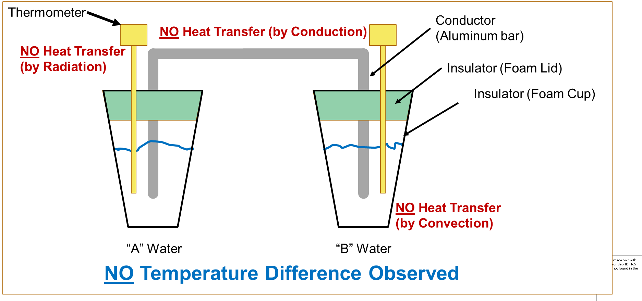
“C”
“D”

Slide 44
Knowledge Check

Slide 45
What must be present to have heat transfer or flow?
A TEMPERATURE DIFFERENCE!
What would happen to the temperatures of the water in the two cups in experiment 1, if left to sit all day?
The temperatures of the cups would eventually become equal. This is referred to as equilibrium.

Slide 46
Are Heat and Temperature the same thing?
YES – 1 finger near chest
NO – 2 fingers near chest
ANSWER: NO

Slide 47
Which direction does heat transfer?
WARM
2
COOL

Slide 48
Thank you for participating in the
CERT Educational Series

